Slide 1
Semantic Image Segmentaion

Slide 2
What is image segmentation ?

Slide 3
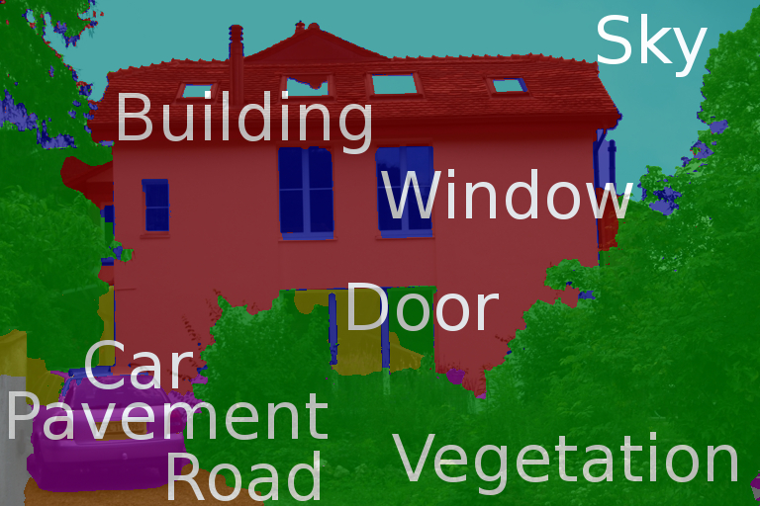
What is image segmentation ?

Slide 4
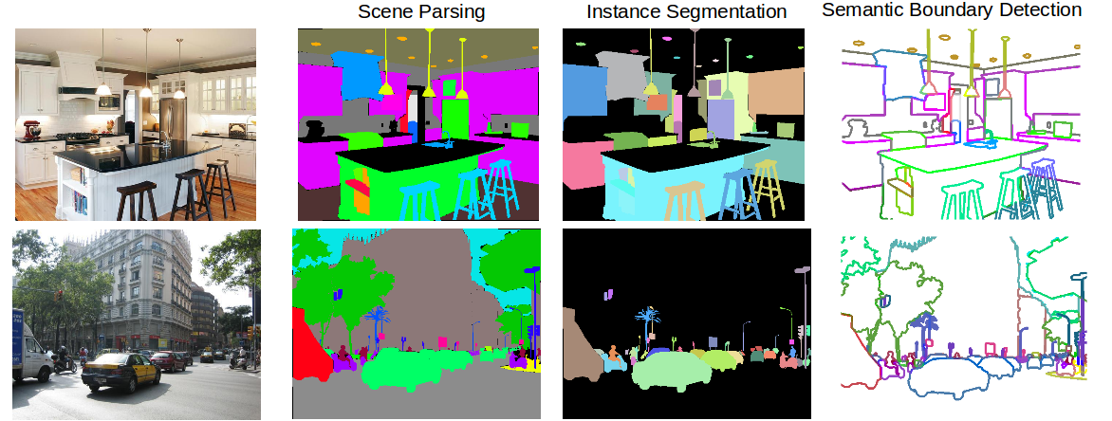
Types of semantic segmentation problems

Slide 5
Our arsenal: Convolution

Slide 6
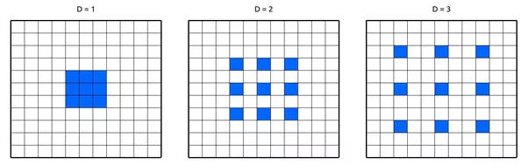
Our arsenal: Atrous(Dilated) Convolution

Slide 7
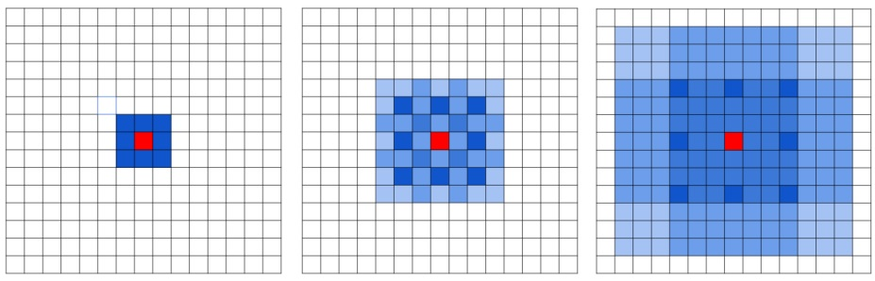
Our arsenal: Atrous(Dilated) Convolution

Slide 8
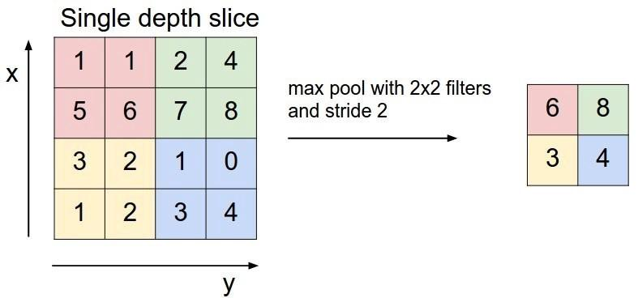
Our arsenal: MaxPooling

Slide 9
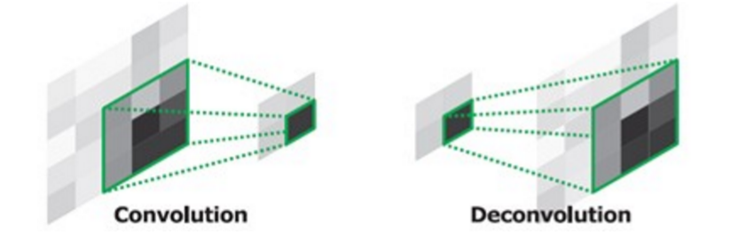
Our arsenal: Deconvolution (Transposed Convolution)

Slide 10
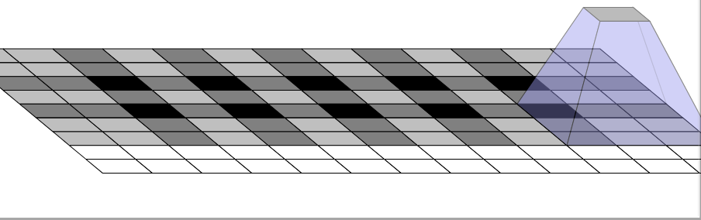
Our arsenal: Deconvolution (Transposed Convolution)

Slide 11
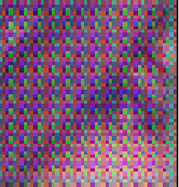
Our arsenal: Deconvolution (Transposed Convolution)

Slide 12
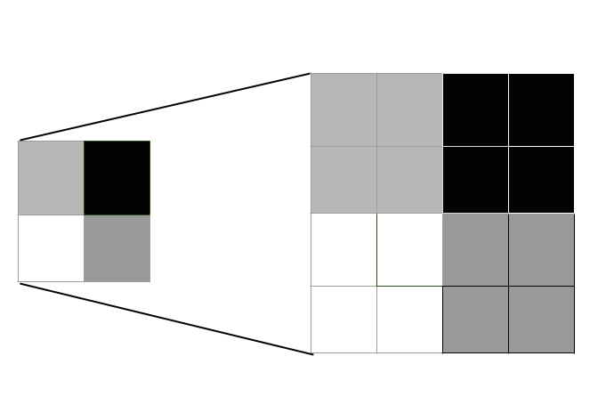
Our arsenal: Upsampling

Slide 13
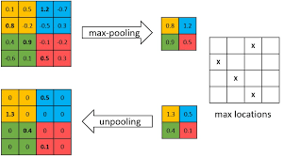
Our arsenal: Unpooling

Slide 14
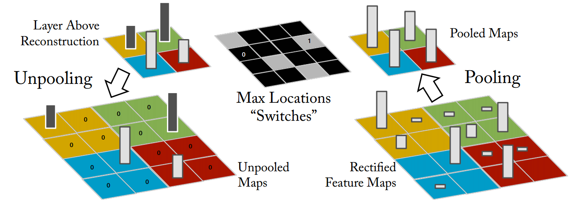
Our arsenal: Unpooling

Slide 15
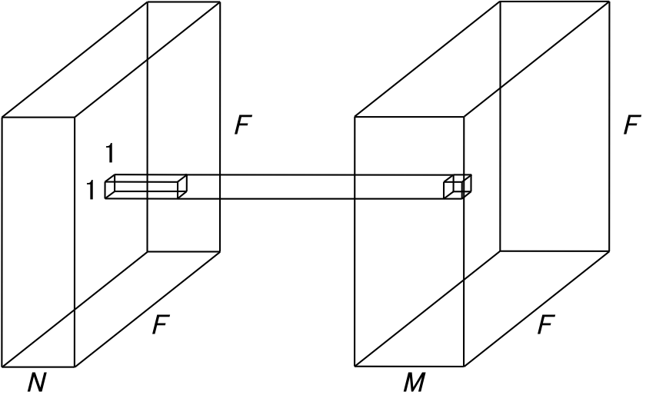
Our arsenal: 1x1 (identity) Convolution

Slide 16
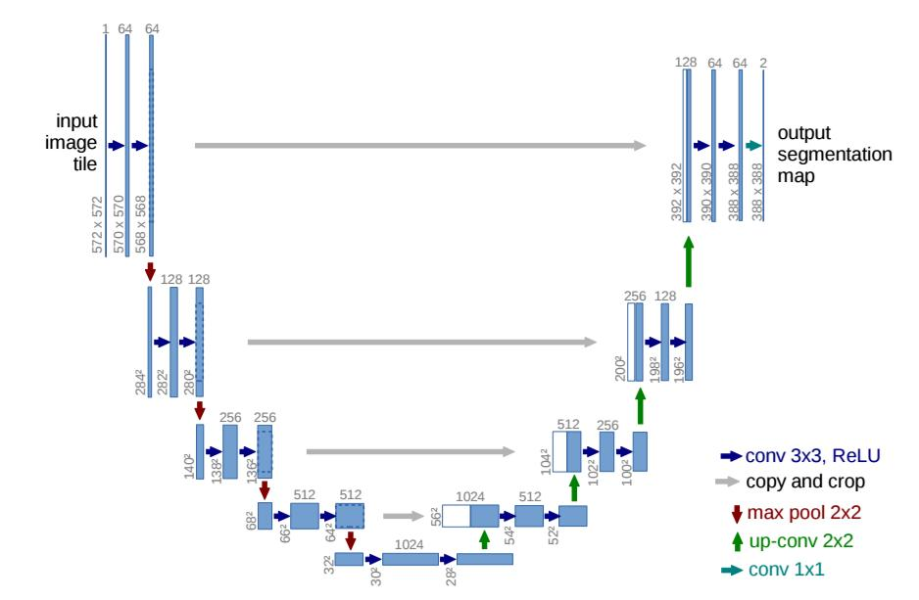
Our arsenal: skip connections

Slide 17
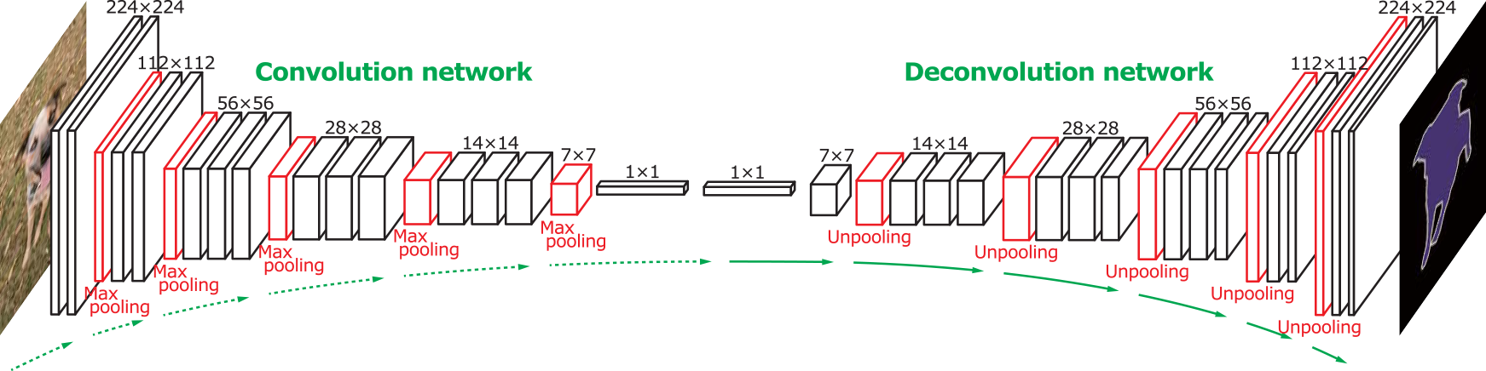
Architectures: DeconvNet

Slide 18
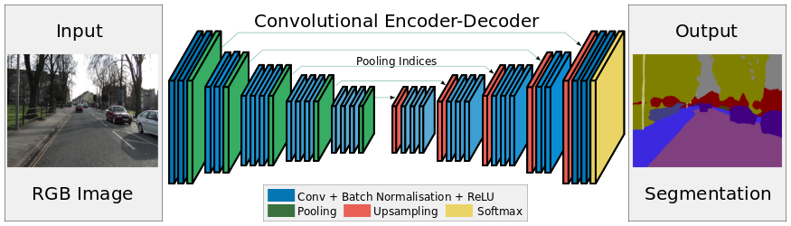
Architectures: SegNet

Slide 19
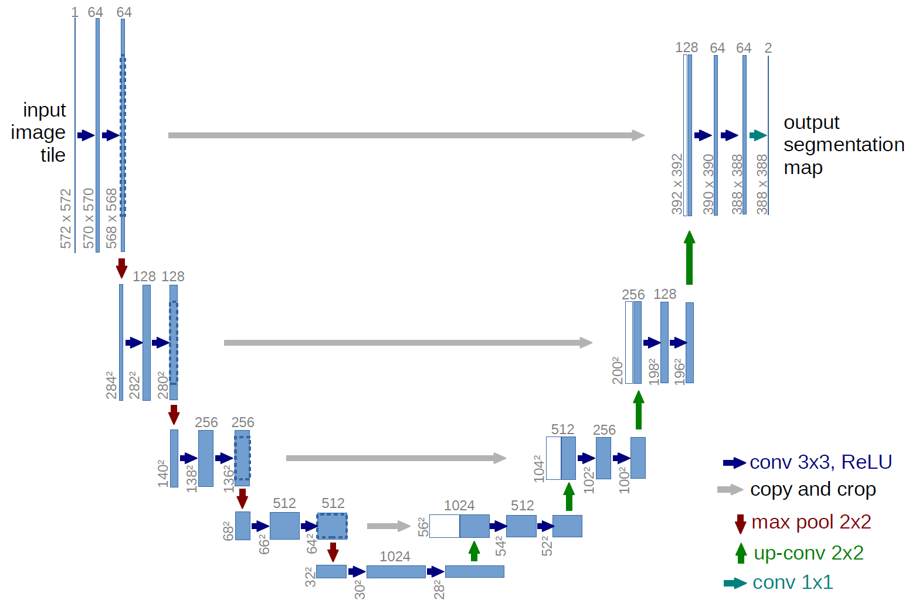
Architectures: Unet

Slide 20
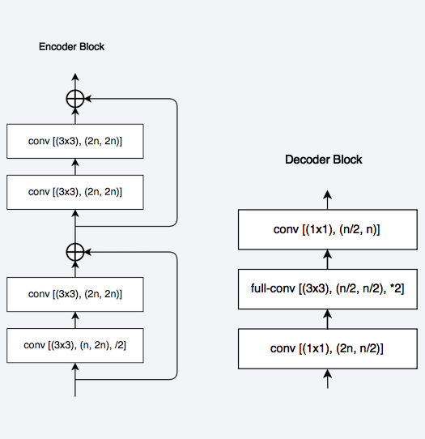
Architectures: LinkNet, Enet

Slide 21
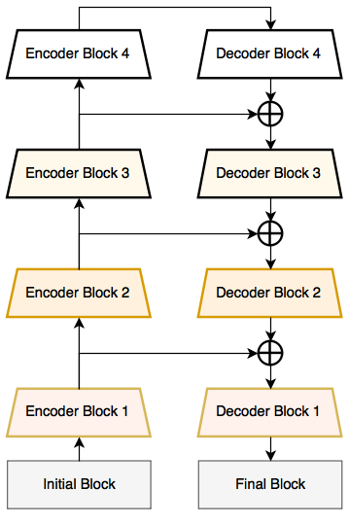
Architectures: LinkNet, Enet

Slide 22
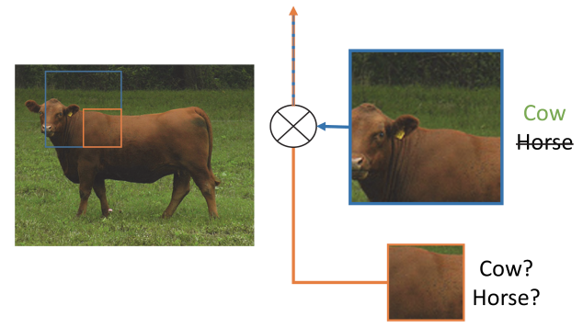
Architectures: PSPNet

Slide 23
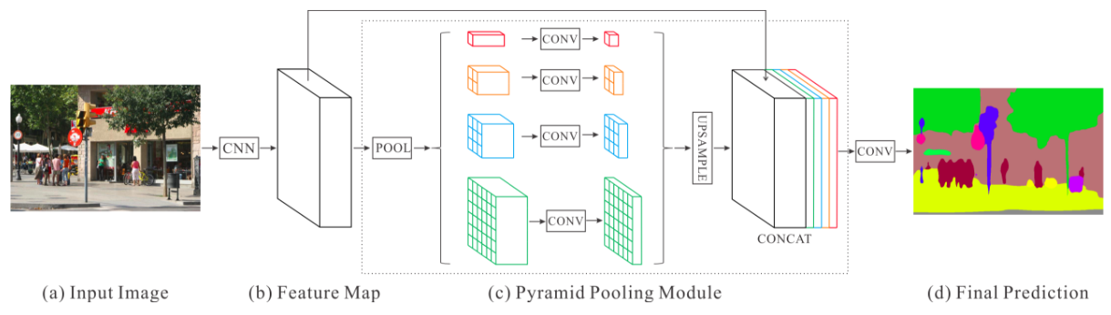
Architectures: PSPNet

